Slide 1
W99702 JPEG
Programming and API
09/93
WCChen

Slide 2
Outline
Features of H/W JPEG
H/W JPEG Programming
H/W JPEG APIs

Slide 3
Features of H/W JPEG
Support to encode interleaved YCbCr 4:2:2/4:2:0 and gray-level (Y only) format image.
Support to decode interleaved YCbCr 4:4:4/4:2:2/4:2:0 and gray-level (Y only) format image.
The encoded JPEG bit-stream format is fully compatible with JFIF and EXIF standards.
Support Capture and JPEG on-the-fly access mode for encode.
Support non multiple-of-16 or multiple-of-8 width and height image encode and decode.
Support three programmable quantization-tables.
Support standard default Huffman-table and programmable Huffman-table for decode.
Support arbitrarily 1X~2X image up-scaling function for encode mode.
Support down-scaling function for encode and decode modes.
Support 2X up-scaling function for decode mode.
Support specified window decode mode.
Support quantization-table adjustment for bit-rate and quality control in encode mode.
Support several special color effect for decode mode.

Slide 4
H/W JPEG Programming

Slide 5
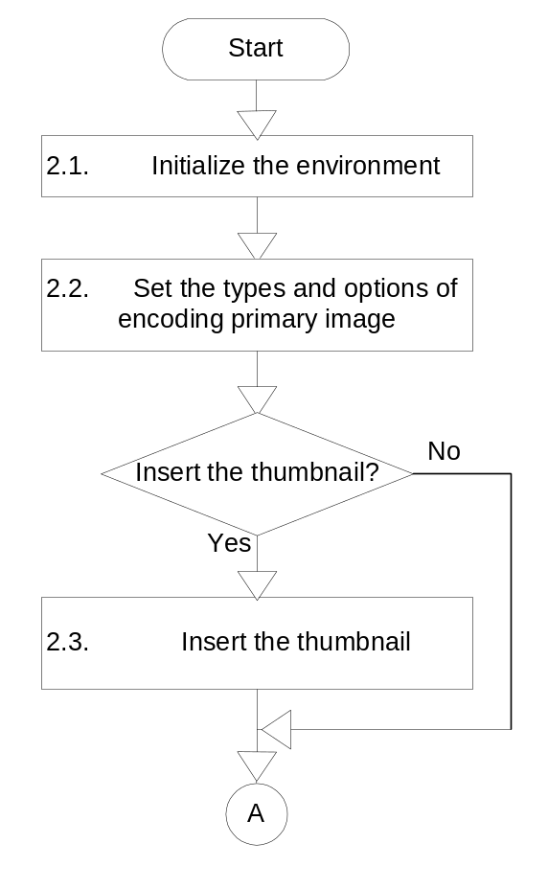
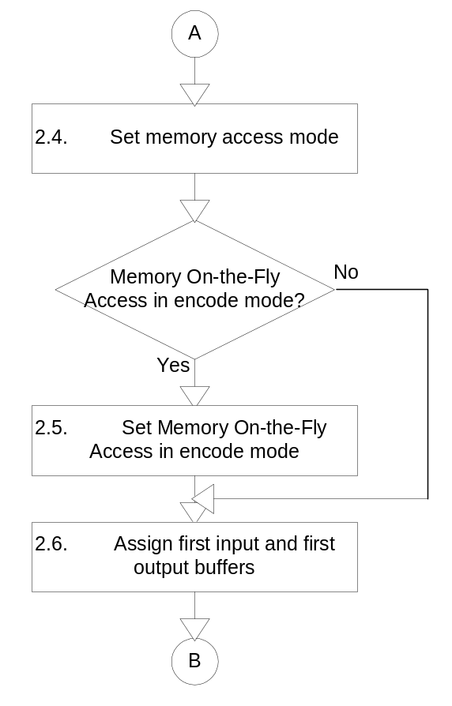
Encoder Programming _{#1}

Slide 6
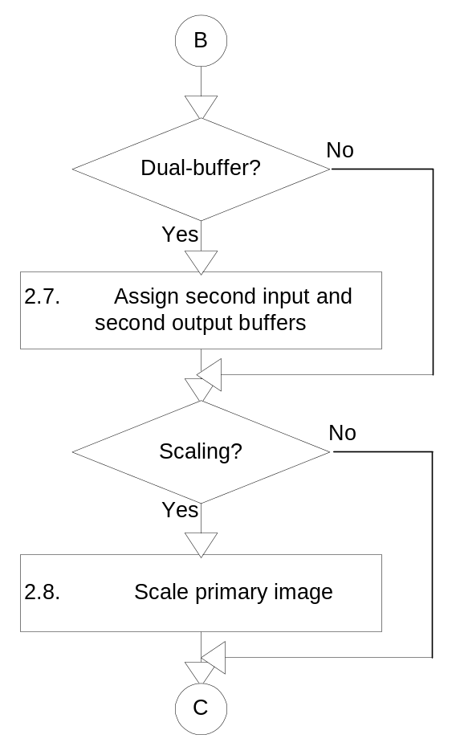
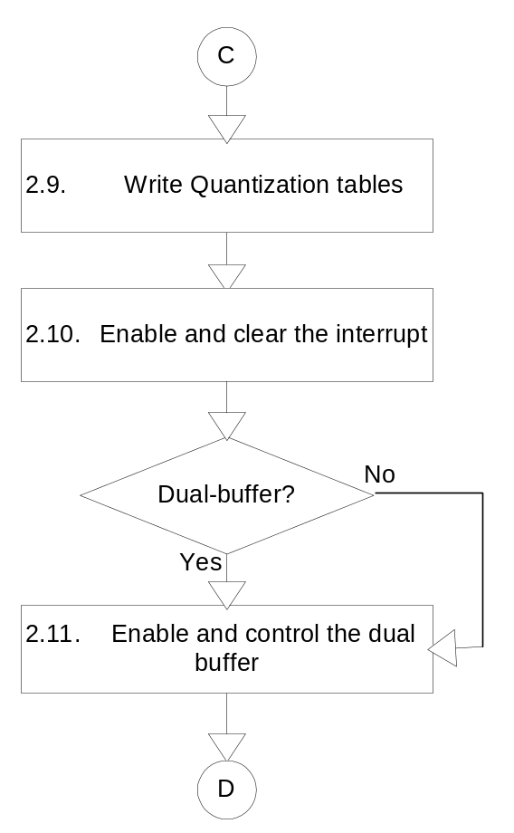
Encoder Programming _{#2}

Slide 7
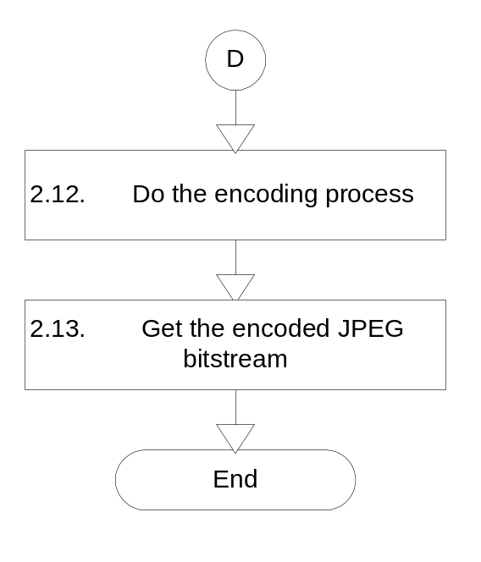
Encoder Programming _{#3}

Slide 8
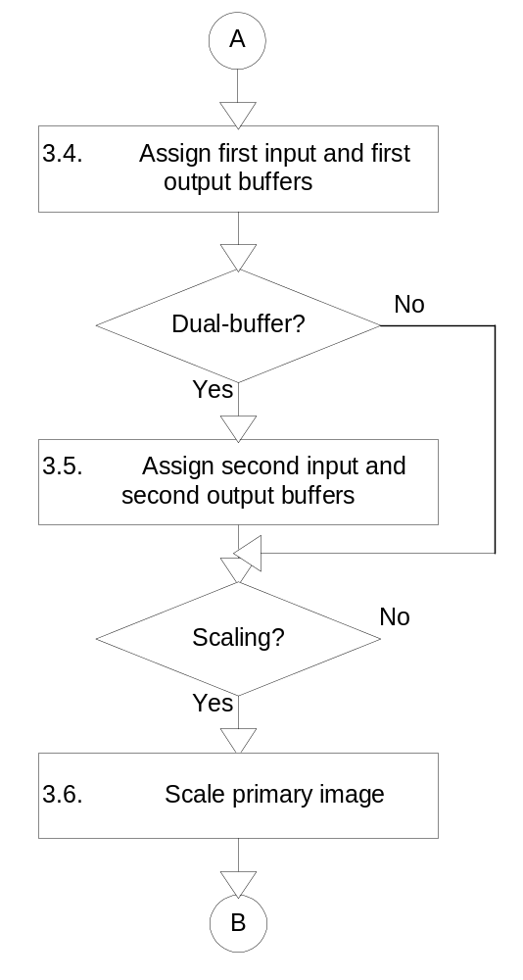
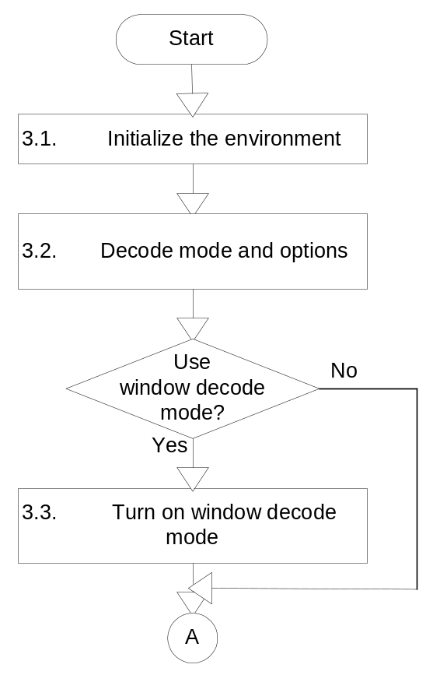
Decoder Programming _{#1}

Slide 9
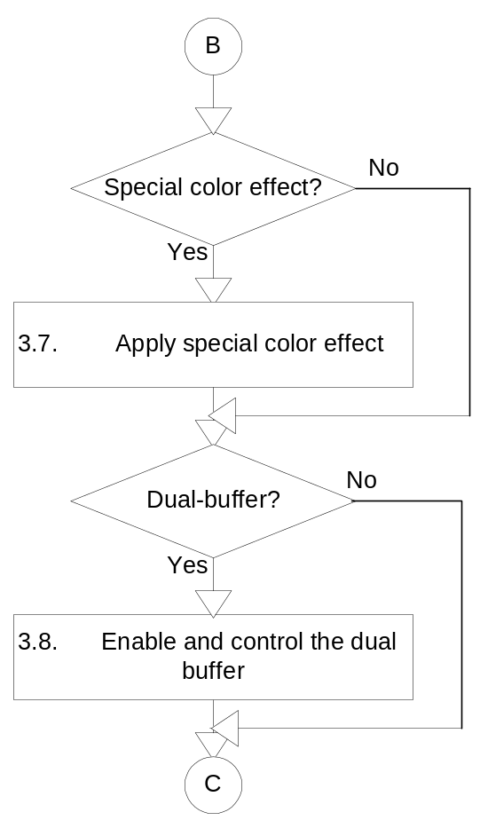
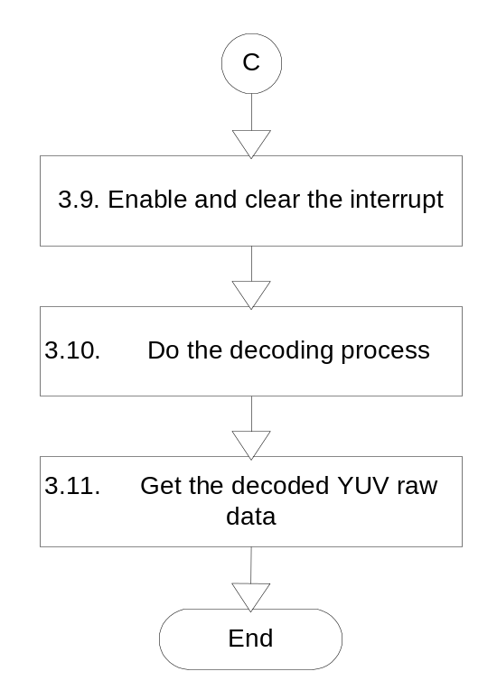
Decoder Programming _{#2}

Slide 10
H/W JPEG APIs

Slide 11
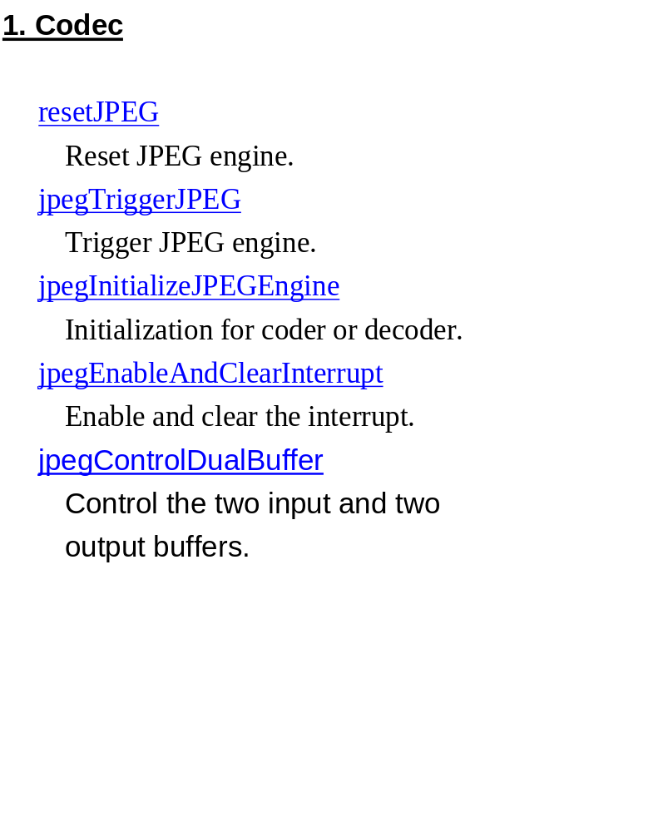
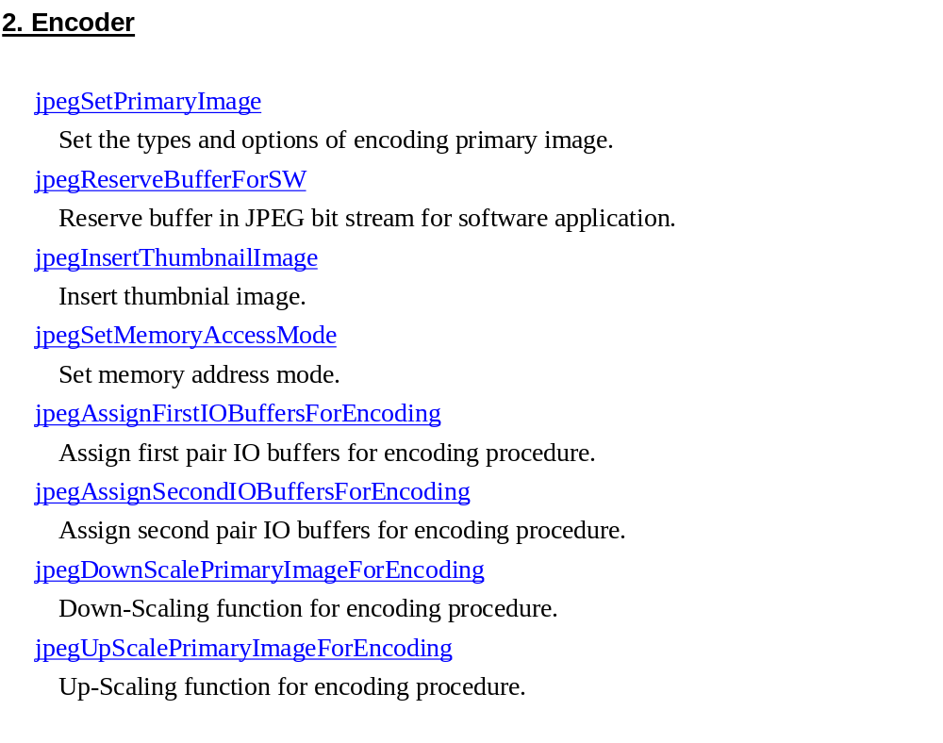
List of APIs _{#1}

Slide 12
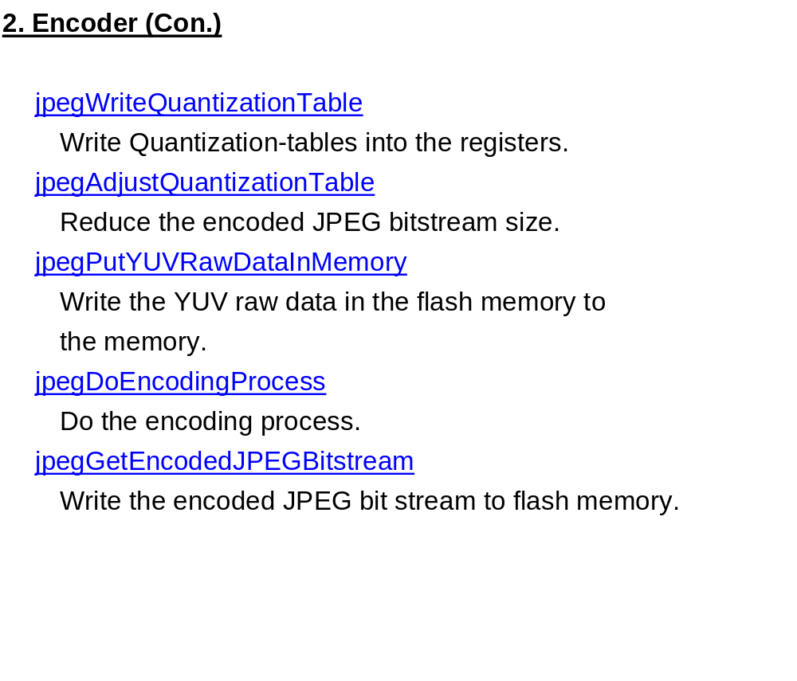
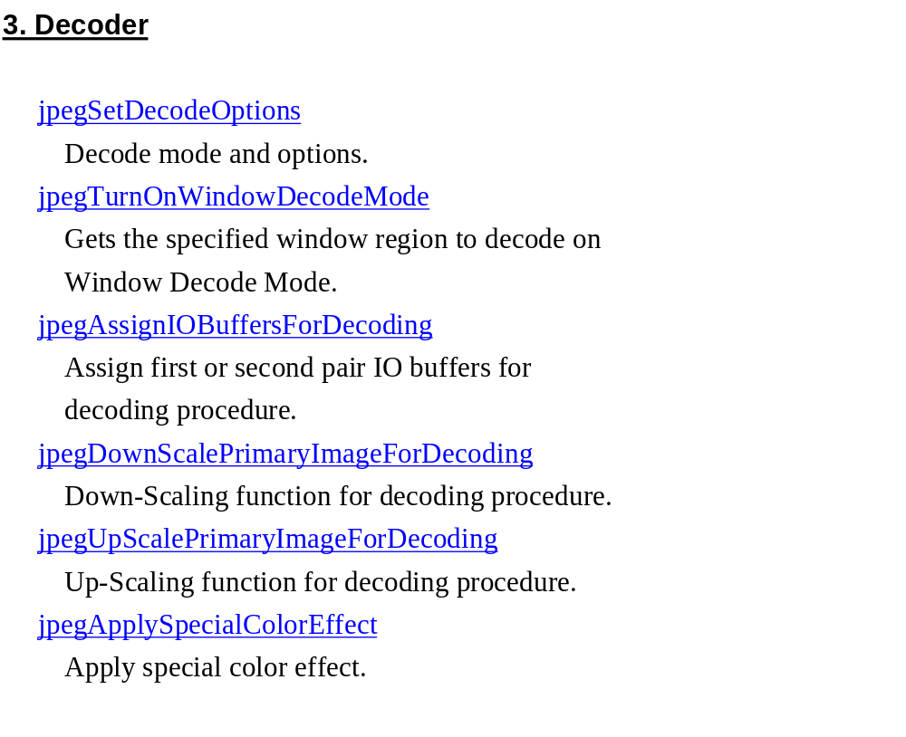
List of APIs _{#2}

Slide 13
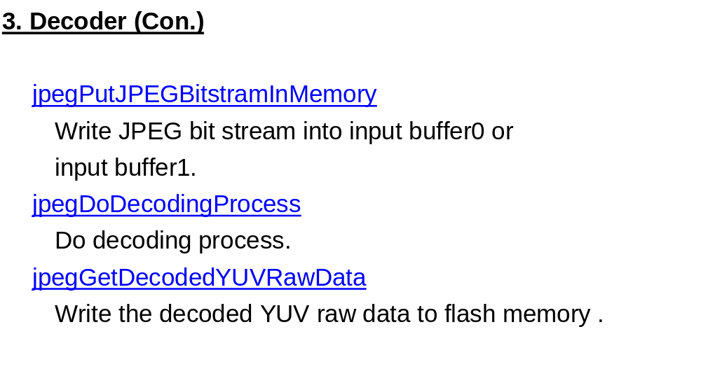
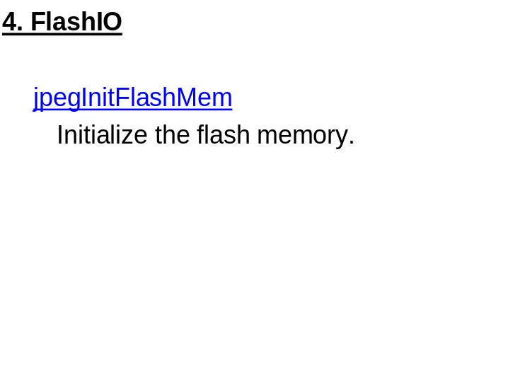
List of APIs _{#3}

Slide 14
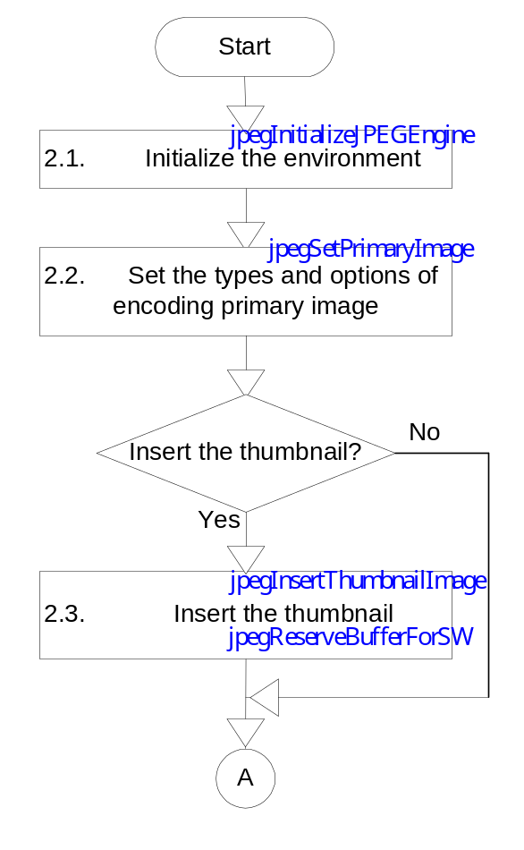
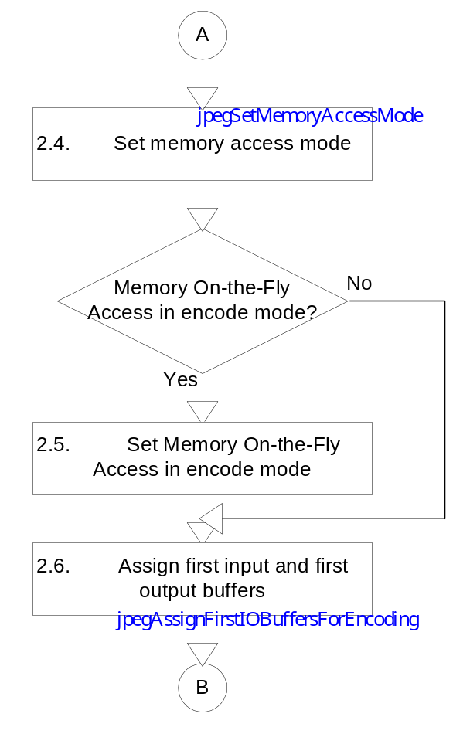
Coding flow of Encoder APIs _{#1}
Blue font is for all memory access mode.
Red font is for dual-buffer memory access mode only.
Violet font is for fix-buffer memory access mode only.

Slide 15
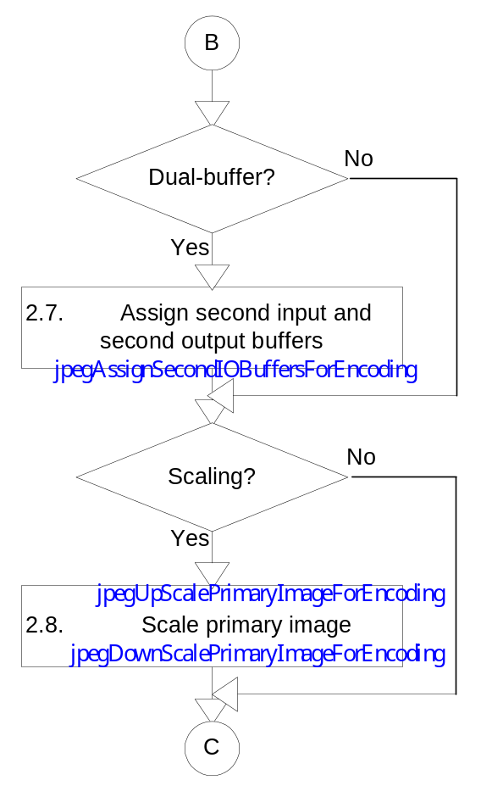
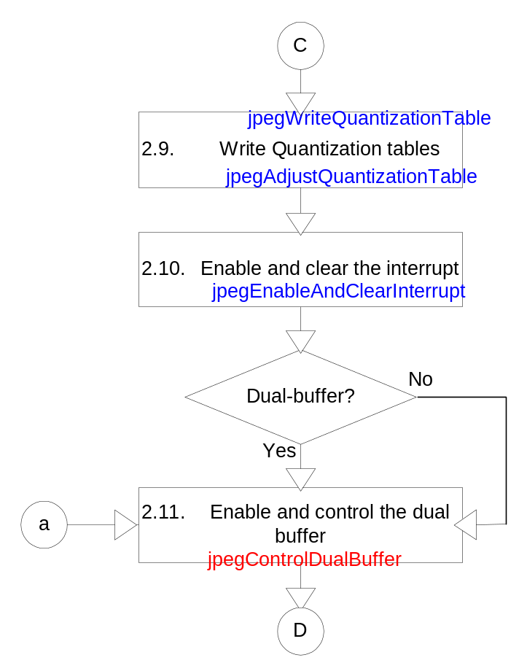
Coding flow of Encoder APIs _{#2}

Slide 16
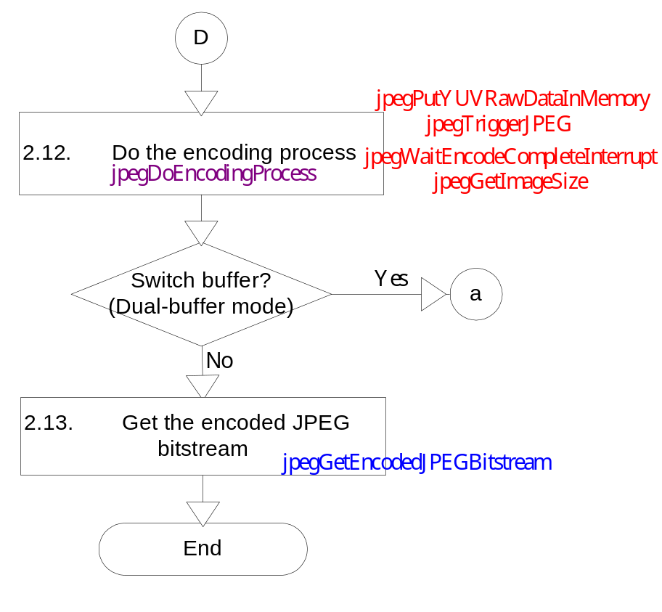
Coding flow of Encoder APIs _{#3}

Slide 17
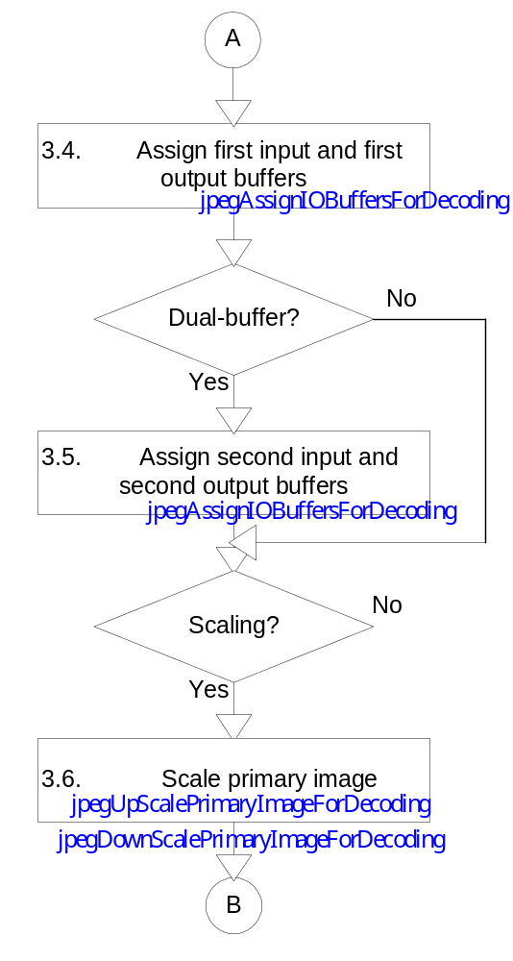
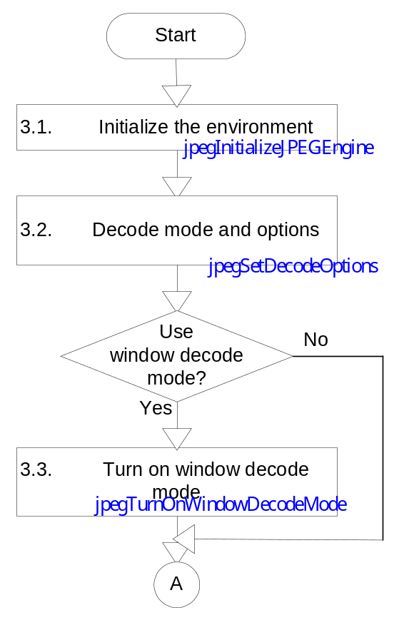
Coding flow of Decoder APIs _{#1}
Blue font is for all memory access mode.
Red font is for dual-buffer memory access mode only.

Slide 18
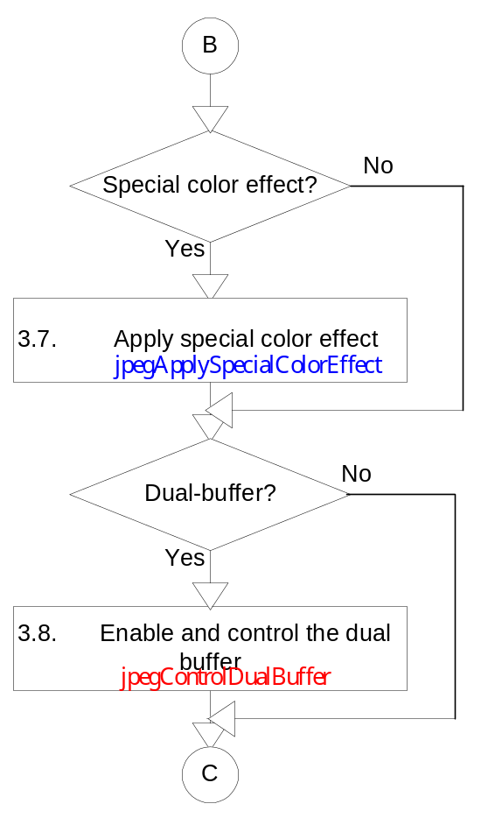
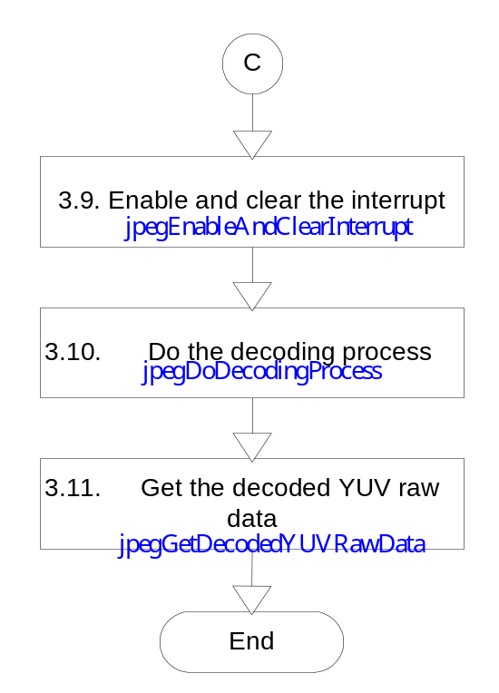
Coding flow of Decoder APIs _{#2}

